Slide 1

HEART RATE MONITOR
K.LIKHITHA
KAJAL NEGI
RAM KISHORE
B.SHILPA

Slide 2

AGENDA
Introduction
Components Required
Block Diagram
Modus Operandi
Heart Sensor Module
Five pulse Formula
SWOT Analysis
Applications
Conclusion

Slide 3
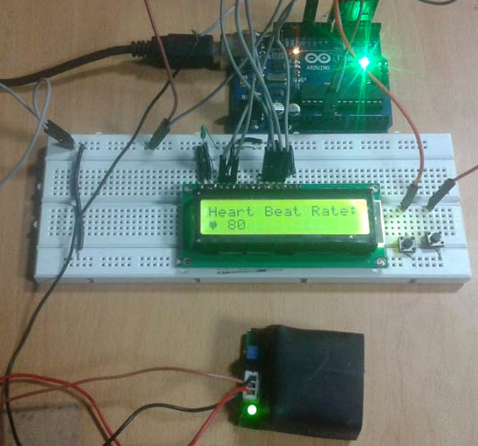
INTRODUCTION
A heart rate monitor is a
personal monitoring device that
allows a subject to measure their
heart rate in real time or record
their heart rate.
Arduino based heartbeat
monitor counts the number of heartbeats in a minute by using heart beat sensor module. It senses the heart beat upon putting the finger on the sensor.

Slide 4
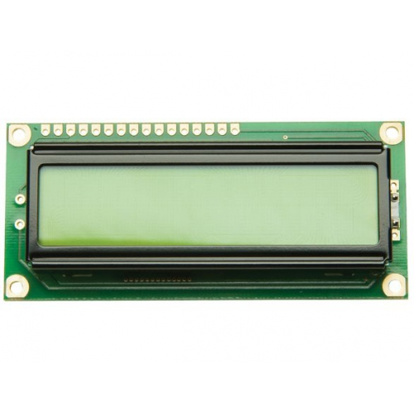
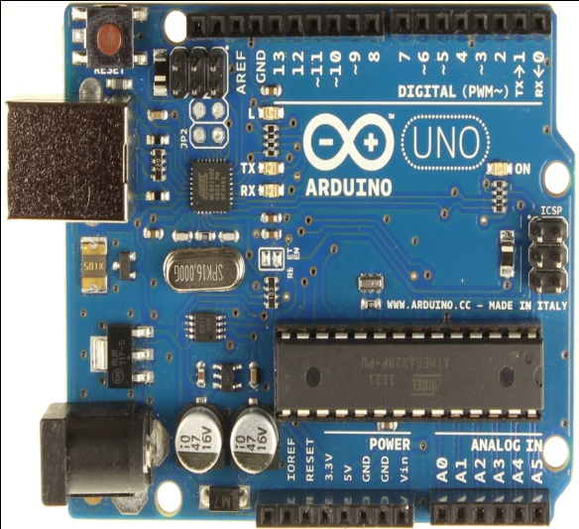
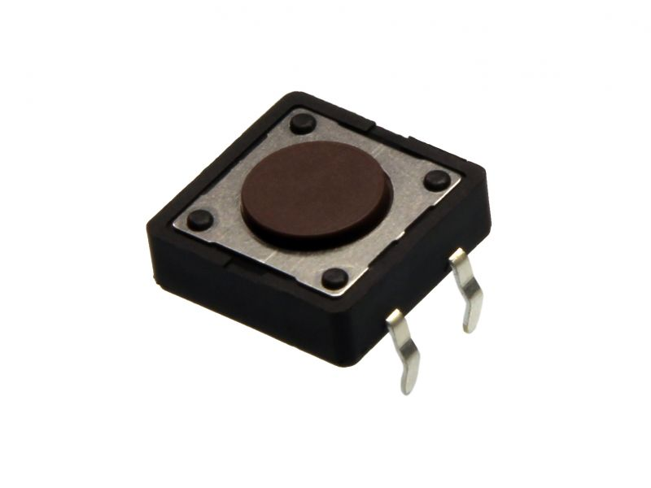
COMPONENTS REQUIRED
Arduino
16x2 LCD
Push Buttons

Slide 5
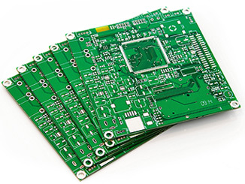
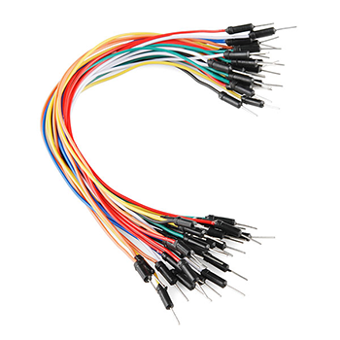
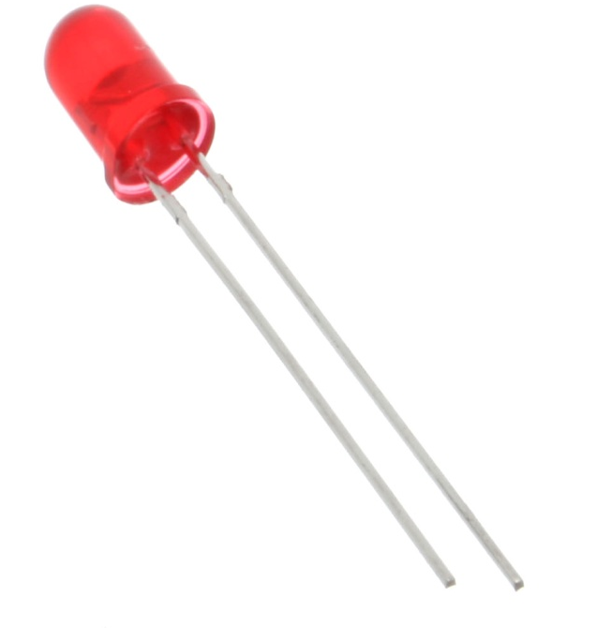
COMPONENTS REQUIRED
Printed Circuit Board
Connecting Wires
LED

Slide 6
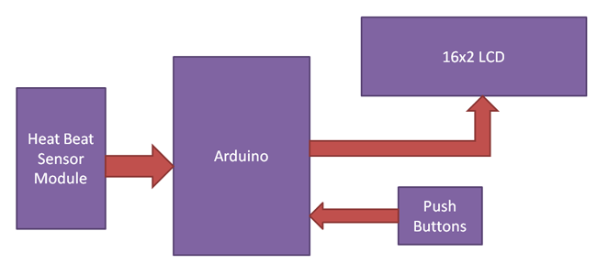
BLOCK DIAGRAM

Slide 7
MODUS OPERANDI
It is based on the principle of photophelthysmography (PPG) . This is an optical technique of finding the heart rate i.e no insertions or attachments on the body.
Circuit of heartbeat monitor contains arduino Uno, heart beat sensor module, reset button and LCD. Arduino controls whole the process of system like reading pulses form Heart beat sensor module, calculating heart rate and sending this data to LCD.

Slide 8
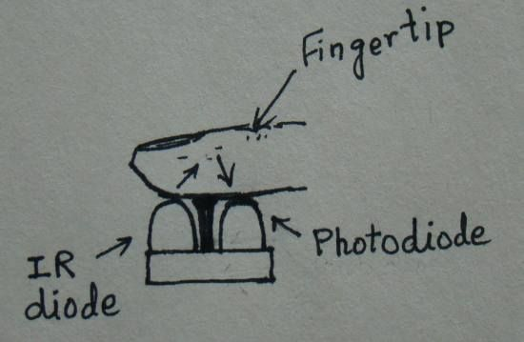
HEART SENSOR MODULE
It consists of IR LED and
photo diode side by side and
the fingertip is placed over
the sensor assembly. The IR
LED transmits an infrared
light into the fingertip,the photo diode senses the portion of the light that is reflected back. With a high gain amplifier, this little alteration in the amplitude of the reflected light can be converted into a pulse.

Slide 9
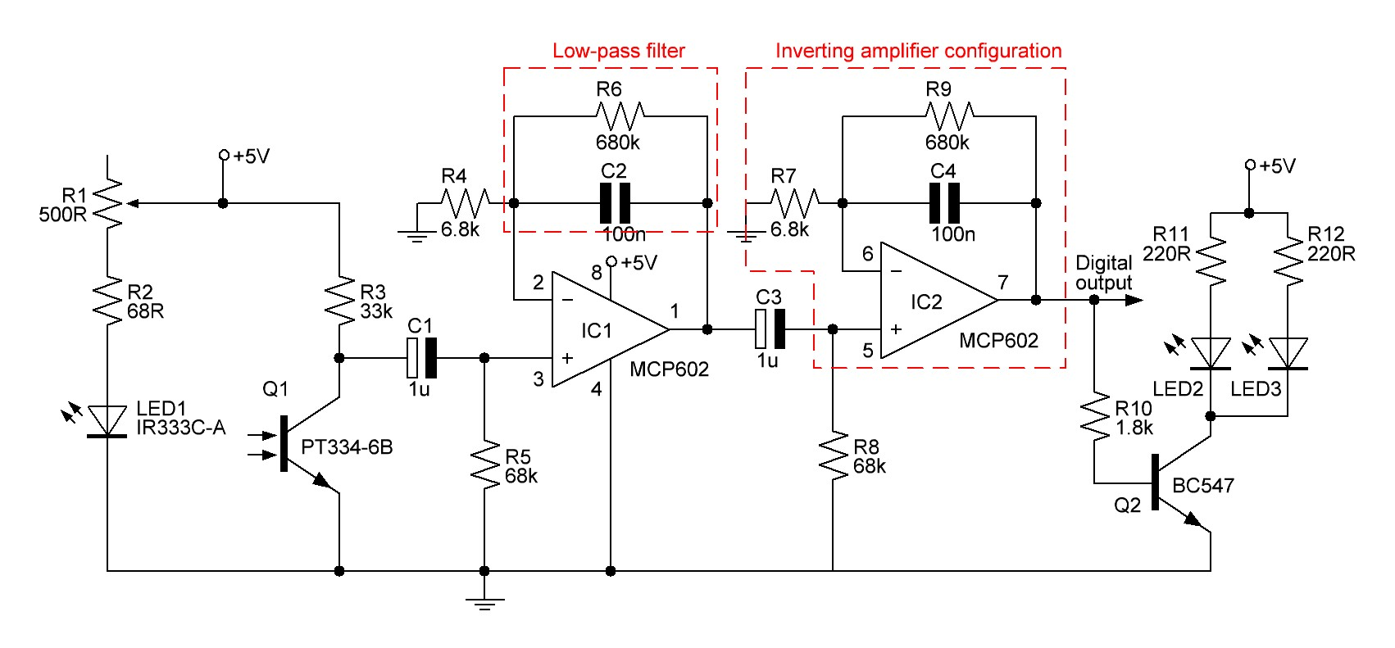
HEART SENSOR MODULE

Slide 10
EXPLANATION
The reflected signal detected by the photo diode is fed to a signal conditioning circuit that filters the unwanted signals and boost the desired pulse signal.
The signal conditioning circuit made of two stage operational amplifiers configured as active low pass filters.
At the output the circuit is connected a LED that will blink with heart beat.

Slide 11
FIVE PULSE FORMULA
There are several methods for calculating heart rate, but here we have read only five pulses. Then we have calculated total heart beat in a minute by applying the below formula:
Five pulse time = time2-time1
Single pulse time = Five pulse time /5
Rate = 60000/ Single pulse time
where time1 is first pulse counter value
time2 is list pulse counter value
Rate is final heart rate.

Slide 12
SWOT ANALYSIS
Strength
Portable, easy to monitor and can be used in most situations
Weakness
Costly and there is a complexity in code
Opportunity
It could potentially play a role in the detection of over training
Threats

Slide 13
APPLICATIONS
Widely used training aid for variety of sports.
It is used in Bio-Medical Engineering.
It helps to manage personal fitness goals which often require exercise to be maintained at some target heart rate

Slide 14
CONCLUSION
Cardiovascular disease is one of the major causes of untimely deaths in world, heartbeat readings are by far the only viable diagnostic
tool that could promote early detection of cardiac events. By using this we can measure ones heart rate through fingertip.

Slide 15


